Slide 1
ANIMAL -10
JEEVANA BHAGYASRI NAGOTHU
1847507
POONAM MEDASANA
1874750
MASTER’S IN AIRO

Slide 2
The Dataset has been taken from Animal10.It contains about 28K medium quality animal images belonging to 10 categories: dog, cat, horse, spyder, butterfly, chicken, sheep, cow, squirrel, elephant.
Image count for each category varies from 2K to 5 K units.
CNN using Transfer Learning Has been implemented.

Slide 3
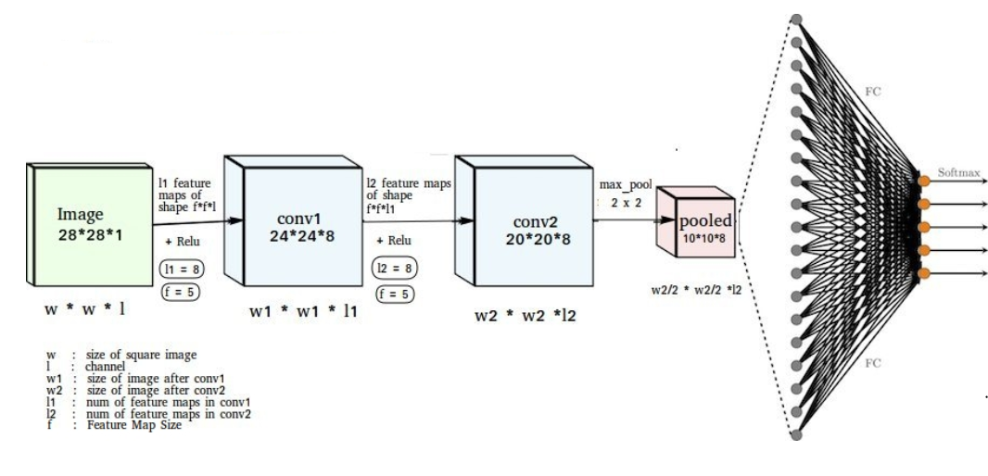
CNN Architecture
INPUT - CONV1 - RELU - CONV2 - RELU- MAXPOOL - FC – OUT

Slide 4
We are creating CNN model using transfer learning for that we are using VGG-16.
VGG-16 (Visual Geometry Group) is a convolutional neural network architecture with 16 layers deep.

Slide 5
Prerequisites
Numpy – Multidimensional Mathematical Computing
Tensorflow - Numerical computation and large-scale machine learning
Keras - Builds and trains neural networks
Matplotlib – Used to plot graph
Pandas - Data manipulation and analysis
Skylearn - Build machine learning models.

Slide 6
Extracting Data
Creating a dataframe, initializing empty train df and appending 500 samples into it
Shuffling input and target for optimum training
foldernames = os.listdir("E:/ANIMAL-10/raw-img")
Categories = [] # list of all categories present in ANIMAL dataset
Files = [] #list of all images in each category
df = pd.DataFrame({
'filename': files,
'category': categories
})
train_df = pd.DataFrame(columns=['filename', 'category'])
train_df = train_df.append(df[df.category == i].iloc[:500,:])
y = train_df['category']
x = train_df['filename']
x, y = shuffle(x, y, random_state=8)

Slide 7
Resizing and Reshaping the input images
Viewing image after preprocessing
Train val split.
def centering_image(img):
size = [256,256]
img_size = img.shape[:2]
row = (size[1] - img_size[0]) // 2
col = (size[0] - img_size[1]) // 2
resized = np.zeros(list(size) + [img.shape[2]], dtype=np.uint8)
resized[row:(row + img.shape[0]), col:(col + img.shape[1])] = img
path = train_df[train_df.category == i].values[1]
val_size = int(round(0.8*len(y)))
x_train = x[:val_size]
y_train = y[:val_size]
x_val = x[val_size:]
y_val = y[val_size:]

Slide 8
One-hot encoding
Input Normalization
ImageDataGenerator for data augmentation
y_train = to_categorical(y_train)
y_val = to_categorical(y_val)
x_train = x_train.astype('float32')
x_val = x_val.astype('float32')
x_train /= 255
x_val /= 255
train_data_gen = ImageDataGenerator(rotation_range=45,
width_shift_range=0.1,
height_shift_range=0.1,
horizontal_flip=True)
train_data_gen.fit(x_train)

Slide 9
Preprocessing Test data
color order is changed
test_images = []
test_df = pd.DataFrame(columns=['filename'])
actual_pred=pd.DataFrame(columns=['Category'])
for i in range(10):
test_df = test_df.append(df[df.category == i].iloc[500:502,:1])
actual_pred=actual_pred.append(df[df.category == i].iloc[500:502,1:])
test_df = test_df.reset_index(drop=True)
actual_pred = actual_pred.reset_index(drop=True)
with tqdm(total=len(test_df)) as k:
for i, file_path in enumerate(test_df.filename.values):
img = cv2.imread(file_path)
img = cv2.cvtColor(img, cv2.COLOR_BGR2RGB)

Slide 10
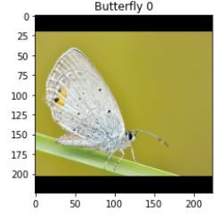
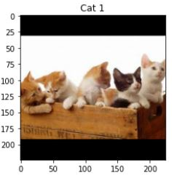
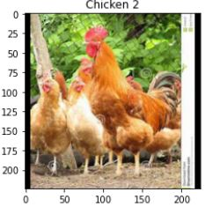
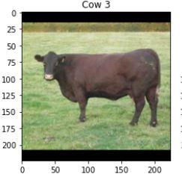
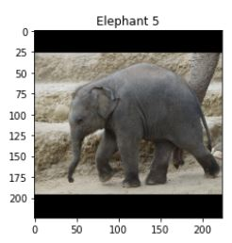
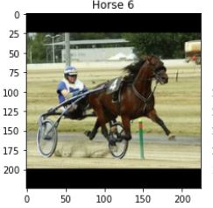
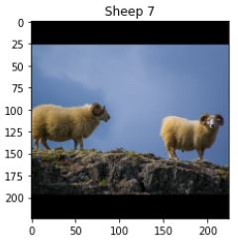
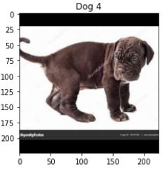
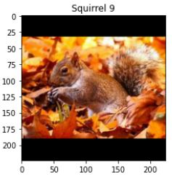
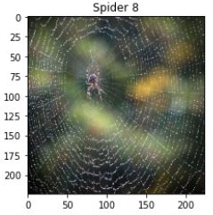

Slide 11
converting images to square
centering the images
output 224*224px
if(img.shape[0] > img.shape[1]):
tile_size = (int(img.shape[1]*256/img.shape[0]),256)
else:
tile_size = (256, int(img.shape[0]*256/img.shape[1]))
img = centering_image(cv2.resize(img, dsize=tile_size))
img = img[16:240, 16:240]
test_images.append(img)
k.update(1)
test_images = np.array(test_images).reshape(-1,224,224,3)

Slide 12
Creating a CNN Models using VGG 16
rows,cols,channel = 224, 224, 3
epochs = 25
learning_rate = 0.001
decay_rate = learning_rate / epochs
momentum =0.9
sgd= optimizers.SGD(lr=learning_rate, momentum=momentum,
decay=decay_rate, nesterov=False)
base_model1 = applications.VGG16(weights='imagenet', include_top=False,
input_shape=(224,224,3))
model1 = Sequential()
model1.add(Flatten(input_shape= base_model1.output_shape[1:]))
model1.add(Dense(256, activation='relu'))
model1.add(Dense(10, activation='softmax'))
vgg16_model = Model(inputs=base_model1.input,
outputs=model1(base_model1.output))
vgg16_model.compile(loss='binary_crossentropy',
optimizer=sgd,metrics=['accuracy'])
vgg16_model.summary()

Slide 13
Training Models -- VGG16
accuracy curves
batch_size =32
epochs = 25
neural_ntwk1 = vgg16_model.fit_generator(train_data_gen.flow(x_train, y_train,
batch_size=batch_size),
steps_per_epoch= x_train.shape[0] // batch_size,
epochs=epochs,validation_data=(x_val, y_val),
callbacks=[ModelCheckpoint('VGG16-transferlearning.model',
monitor='val_acc')])
print("VGG16: Epochs={0:d}, Train accuracy={1:.5f}, Val accuracy={2:.5f}".format(epochs,neural_ntwk1.history['accuracy'][epochs-1],
neural_ntwk1.history['val_accuracy'][epochs-1]))
def show_plots(neural_ntwk):
loss_vals = neural_ntwk['loss']
val_loss_vals = neural_ntwk['val_loss']
epochs = range(1, len(neural_ntwk['accuracy'])+1)
f, ax = plt.subplots(nrows=1,ncols=2,figsize=(16,4))

Slide 14
plot accuracies
ax[0].plot(epochs, loss_vals, color='R',marker='o',linestyle=' ', label='Train Loss')
ax[0].plot(epochs, val_loss_vals, color='B',marker='*', label='Val Loss')
ax[0].set(title='Train & Val Loss', xlabel='Epochs',ylabel='Loss')
ax[0].legend(loc='best')
ax[0].grid(True)
acc_vals = neural_ntwk['accuracy']
val_acc_vals = neural_ntwk['val_accuracy']
ax[1].plot(epochs, acc_vals, color='navy', marker='o',
ls=' ', label='Train Accuracy')
ax[1].plot(epochs, val_acc_vals, color='firebrick',
marker='*', label='Val Accuracy')
ax[1].set(title='Train & Val Accuracy',xlabel='Epochs',ylabel='Accuracy')
ax[1].legend(loc='best')
ax[1].grid(True)
plt.show()
plt.close()

Slide 15
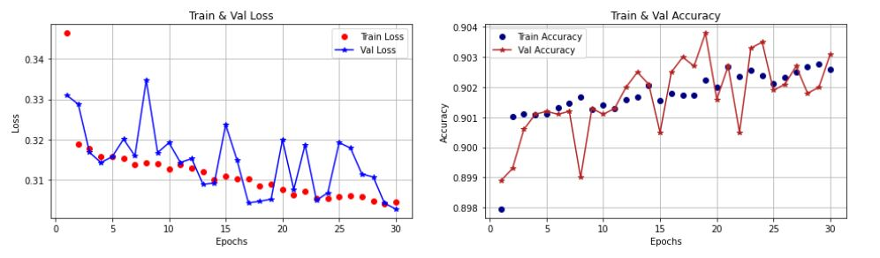
VGG16: Epochs=25, Train accuracy=0.97040, Val accuracy=0.96210.

Slide 16
delete locals from heap before exiting
show_plots(neural_ntwk1.history)
Predicting Categories for Test Data.
Viewing Predictions
del loss_vals, val_loss_vals, epochs, acc_vals, val_acc_vals
show_plots(neural_ntwk1.history)
test_prediction1 = vgg16_model.predict(test_images)
actual_pred['category']=actual_pred['category'].astype('int')
for i in range(20):
predict1= test_prediction1[i].argmax()
actual=actual_pred['category'][i]
plt.imshow(test_images[i])
plt.title("Actual: {1}, VGG: {0}".format((animal_names[actual]),(animal_names[predict1])), fontsize=10)
plt.show()

Slide 17
